Slide 1
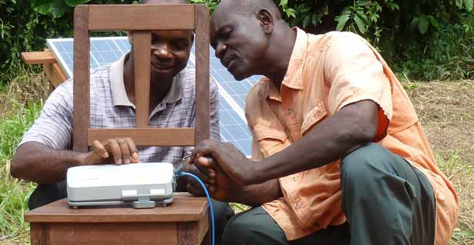
Software Tools for Translation

Slide 2





Technical Tools for Translators:

Slide 3

Technical Tools available at
Bibleineverylanguage.org

Slide 4
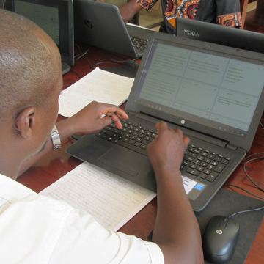
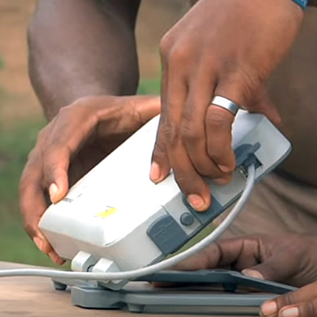
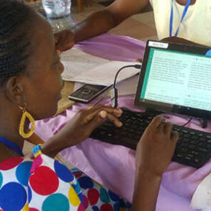
?
Consider:
Accessibility to laptops
Which tool works best?
Accessibility to good internet
Computer literacy of translators

Slide 5
Translation Resources Notes, Words, Questions, Topics available in:
Bibleineverylanguage.org

